Slide 1


KING COUNTY, WASHINGTON HOUSING MARKET
COOL FLO REAL ESTATE
2024
Client: THOMAS HANSEN

Slide 2
21,420
COOL FLO REAL ESTATE
2024
Available houses and apartments in King County
Year of Construction
1900 – 2015
Average: 1971
Price Range
78k – 7.7m
Average: 542k
King County Grade
3 – 13
Average: 7.7
Condition
1 – 5
Average: 3.4

Slide 3
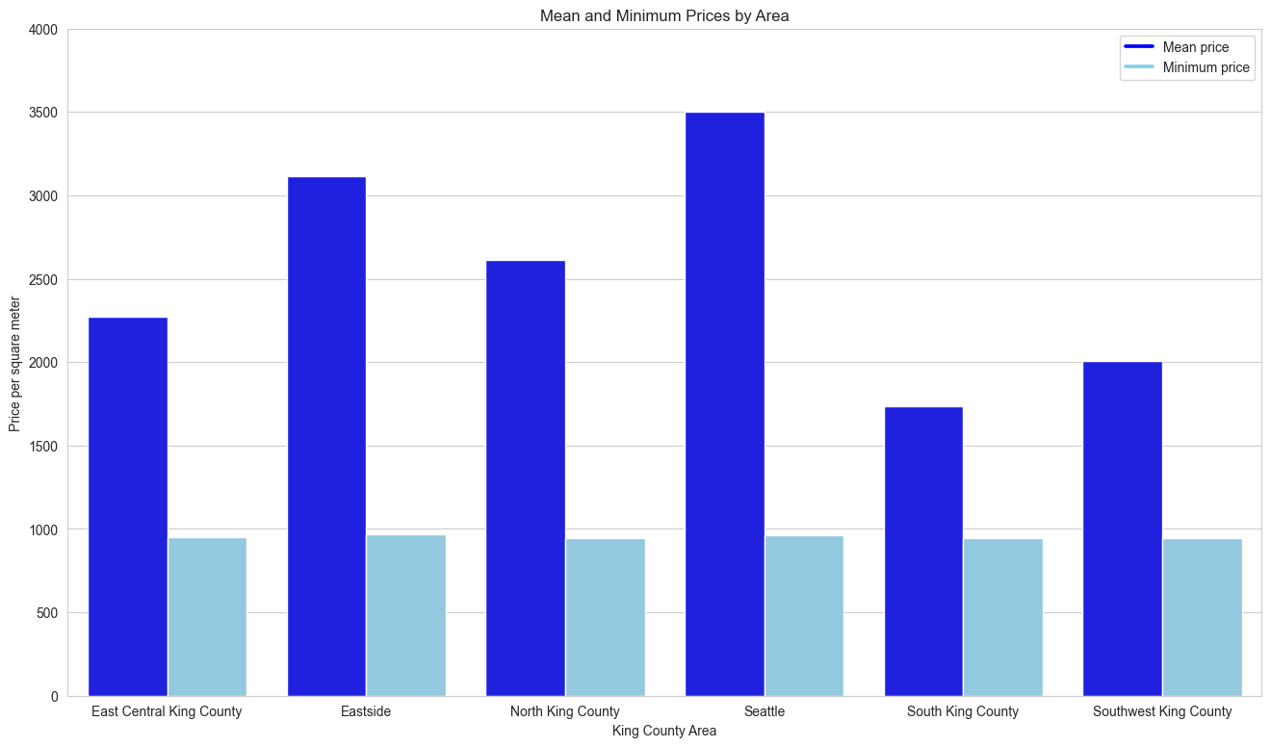
South and Southwest Most Affordable
COOL FLO REAL ESTATE
2024
Comparatively cheap housing (<1000$ per sqm) is available in all King County areas
South and southwest with lowest mean prices, Seattle with highest

Slide 4
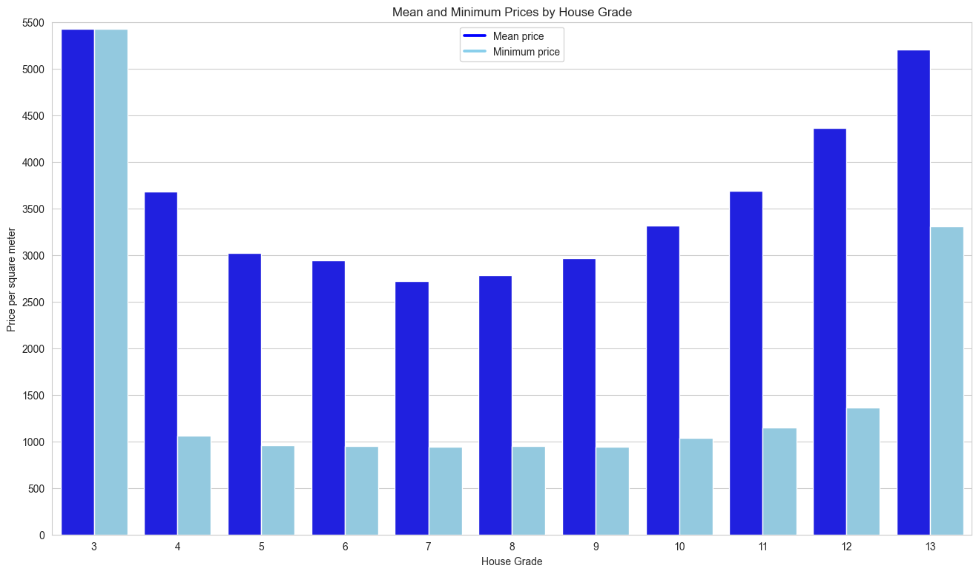
Grades 7 and 8 with lowest average prices
COOL FLO REAL ESTATE
2024
Better house grade does not necessarily mean higher price per square meter
Houses under 1000$ per square meters available in grades 5 to 9

Slide 5
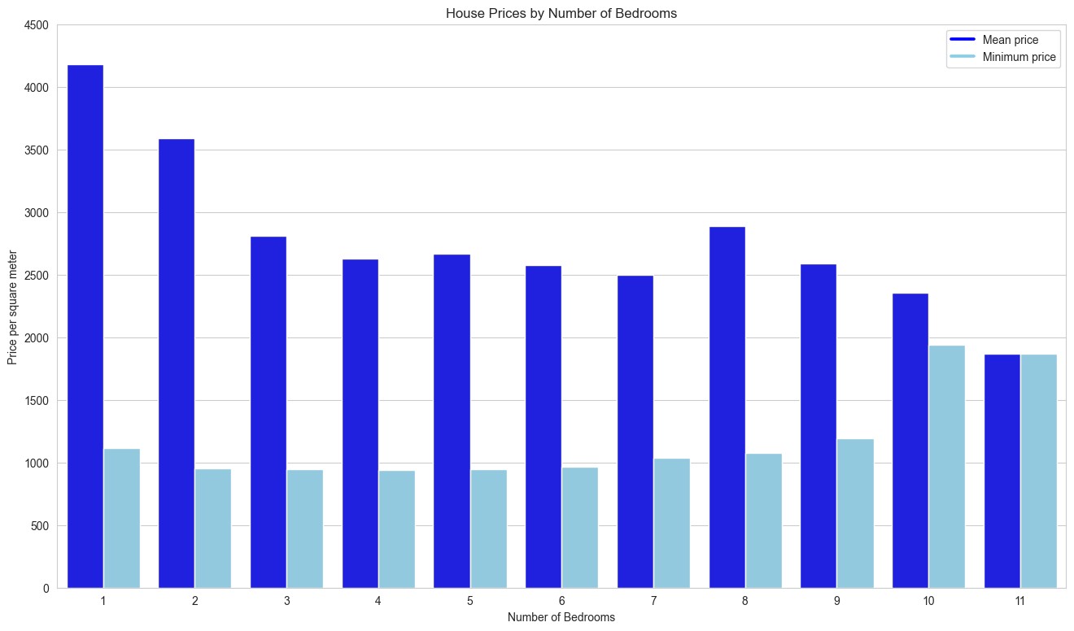
More value for money with more bedrooms
COOL FLO REAL ESTATE
2024
Generally, the higher the number of bedrooms, the lower the per sqm price
Highest minimum price per square meter at 10 bedrooms

Slide 6
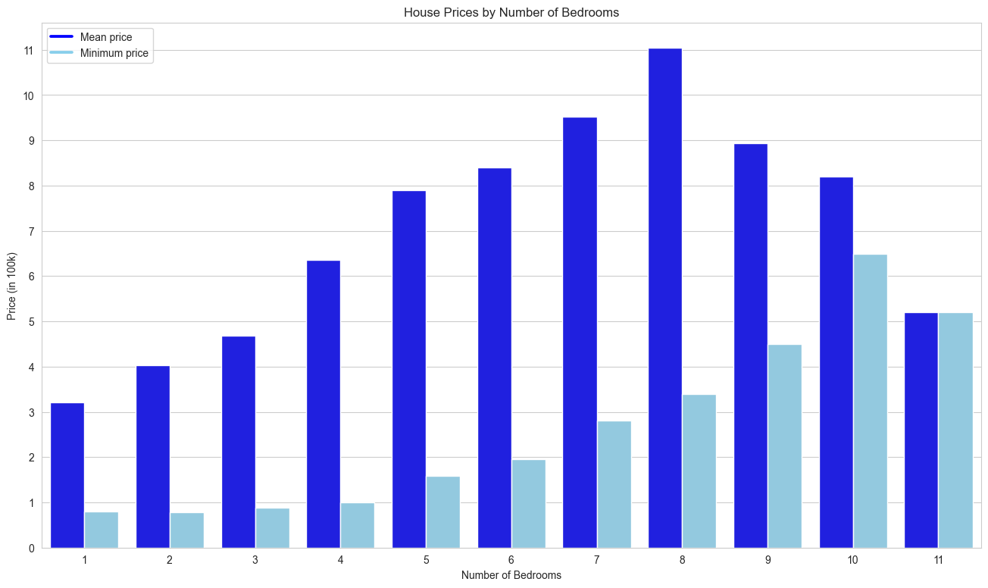
More Bedrooms Usually Means Higher Price
COOL FLO REAL ESTATE
2024
Peak of average price at 8 bedrooms
Highest minimum price at 10 bedrooms
Affordable (<200k) houses with 5 or 6 bedrooms on the market

Slide 7
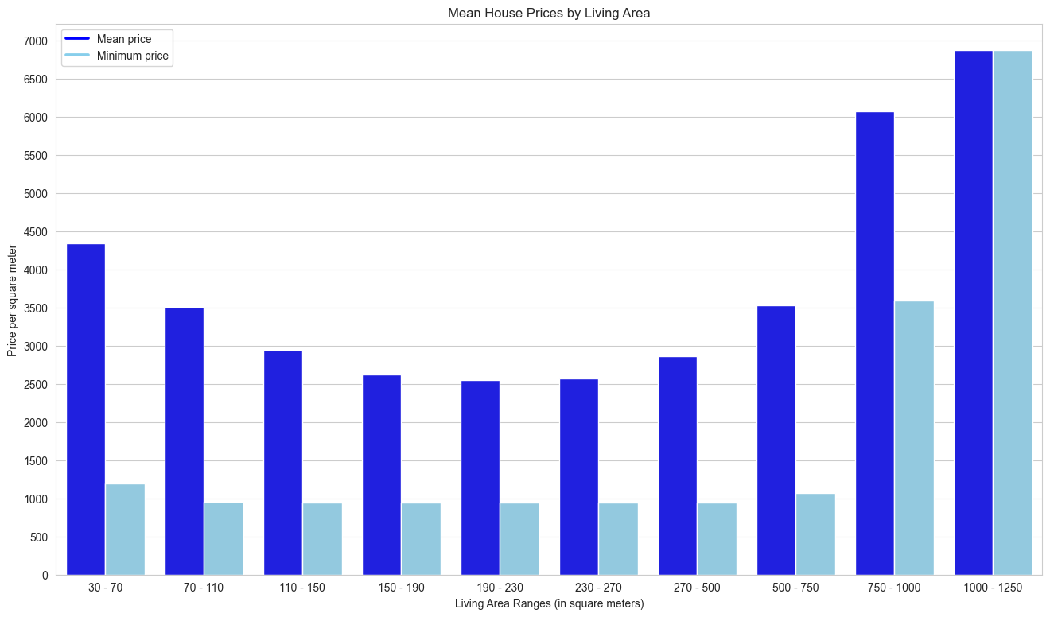
Living Area by Price per Square Meter
COOL FLO REAL ESTATE
2024
More living space does not necessarily mean higher price per sqm
Houses with a sqm price under 1000$ available in the ranges from 70 to 270 sqm

Slide 8
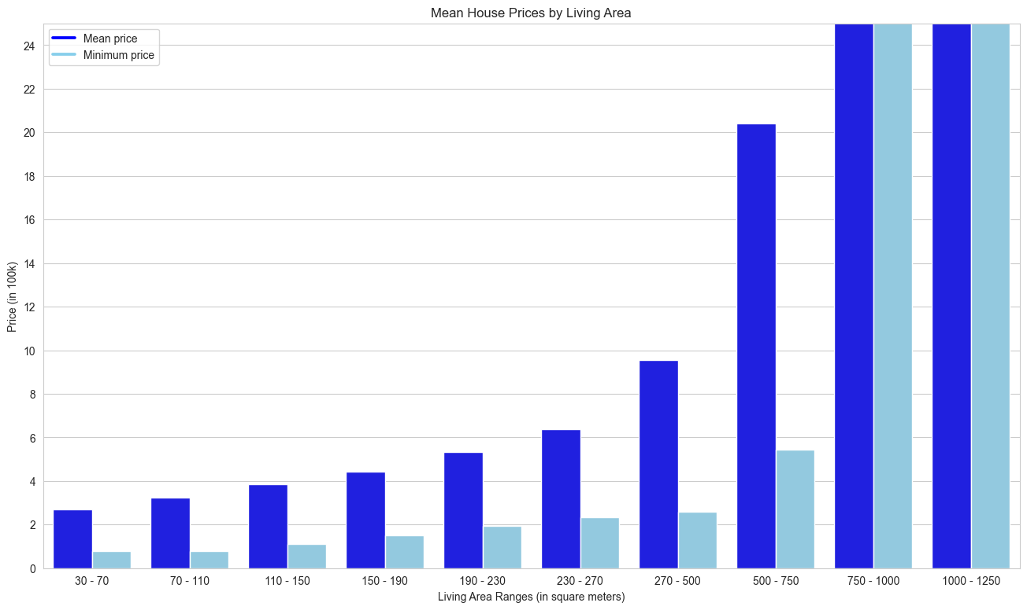
Living Area by Total House Price
COOL FLO REAL ESTATE
2024
The bigger the living area, the higher the house price
Affordable houses (<200k) available up to 230 square meters living area

Slide 9
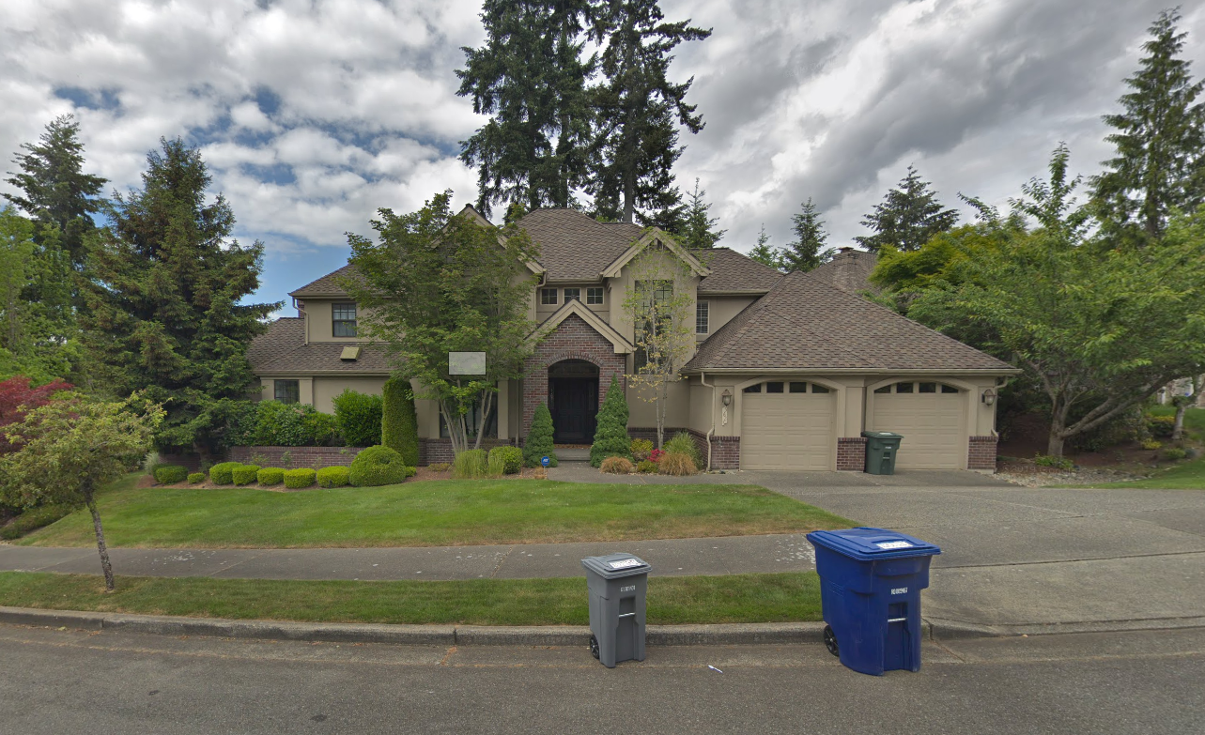
Recommendation #1
COOL FLO REAL ESTATE
2024
5697 167th Pl SE, Bellevue, WA 98006, USA
Living area: 1,680 sqft (156 sqm)
Property area: 8,400 sqft (780 sqm)
Bedrooms: 5
King County Housing Grade: 7
Overall condition: 4
Price: 175,000 $
Price per square meter: 1121.25 $

Slide 10
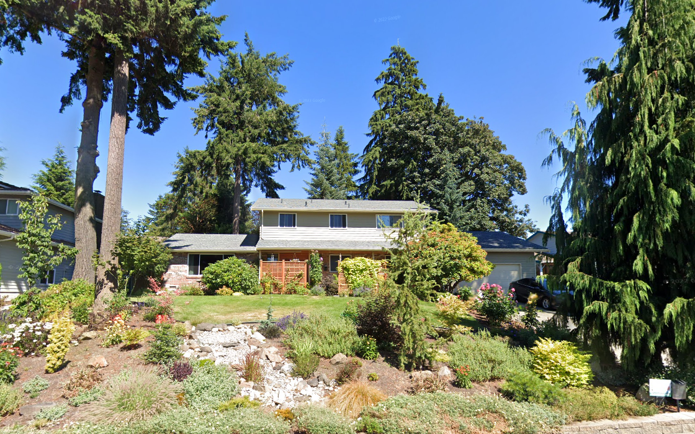
Recommendation #2
COOL FLO REAL ESTATE
2024
30244 25th Ave SW, Federal Way, WA 98023, USA
Living area: 1,710 sqft (158 sqm)
Property area: 8,100 sqft (753 sqm)
Bedrooms: 5
King County Housing Grade: 7
Overall condition: 4
Price: 158,550 $
Price per square meter: 998.03 $

Slide 11
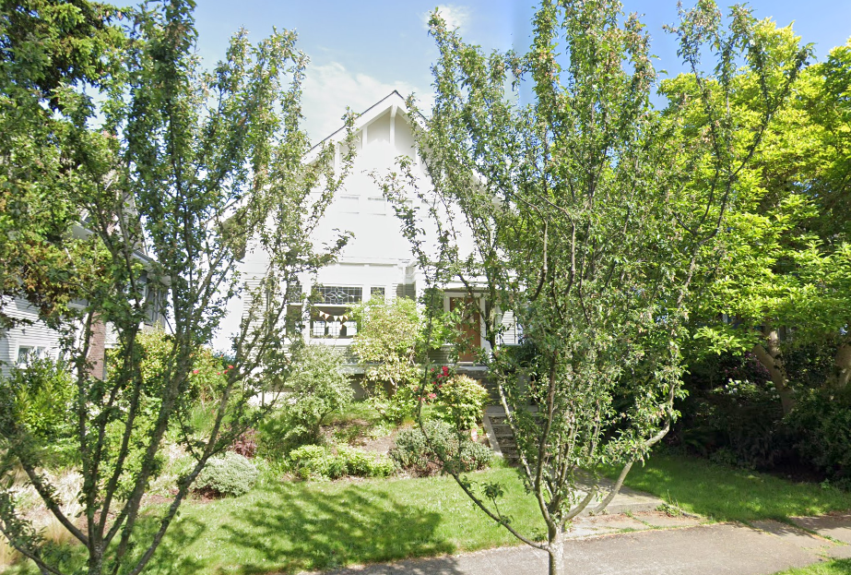
Recommendation #3
COOL FLO REAL ESTATE
2024
2826 10th Ave E, Seattle, WA 98102, USA
Living area: 1,740 sqft (161 sqm)
Property area: 8,750 sqft (813 sqm)
Bedrooms: 5
King County Housing Grade: 7
Overall condition: 4
Price: 199,950 $
Price per square meter: 1236.93 $

